Slide 1

Software QUALITY ENGINERING
Testing Basics

Slide 2
What Is Testing
Software Testing is evaluation of the software against requirements gathered from users and system specifications. Testing is conducted at the phase level in software development life cycle or at module level in program code. Software testing comprises of Validation and Verification.

Slide 3
What is Alpha Testing ?
Alpha testing is one of the most common software testing strategy used in software development. Its specially used by product development organizations. • This test takes place at the developer’s site. Developers observe the users and note problems. • Alpha testing is testing of an application when development is about to complete. Minor design changes can still be made as a result of alpha testing. • Alpha testing is typically performed by a group that is independent of the design team, but still within the company, e.g., in-house software test engineers, or software QA engineers.

Slide 4
What is Beta testing?
Beta Testing is also known as field testing. It takes place at customer’s site. It sends the system/software to users who install it and use it under real-world working conditions. Beta Testing of a product is performed by "real users" of the software application in a "real environment" and can be considered as a form of external User Acceptance Testing. Beta version of the software is released to a limited number of end- users of the product to obtain feedback on the product quality. Beta testing reduces product failure risks and provides increased quality of the product through customer validation. Beta Test provides a complete overview of the true experience gained by the end users while experiencing the product.

Slide 5
Alpha Testing
Alpha Testing Beta Testing Alpha testing performed by Testers who are usually internal employees of the organization Alpha Testing performed at developer's site Reliability and Security Testing are not performed in-depth Alpha Testing Long execution cycle may be required for Alpha testing
Beta Testing
Beta testing is performed by Clients or End Users who are not employees of the organization Beta testing is performed at client location or end user of the product Reliability, Security, Robustness are checked during Beta Testing Only few weeks of execution are required for Beta testing

Slide 6
Gamma Testing
Gamma testing is the final stage of the testing process conducted before software release. It makes sure that the product is ready for market release according to all the specified requirements. Gamma testing focuses on software security and functionality. But it does not include any in-house QA activities. During gamma testing, the software does not undergo any modifications unless the detected bug is of a high priority and severity.
Only a limited number of users perform gamma testing, and testers do not participate. The checking includes the verification of certain specifications, not the whole product. Feedback received after gamma testing is considered as updates for upcoming software versions. But, because of a limited development cycle, gamma testing is usually skipped.

Slide 7
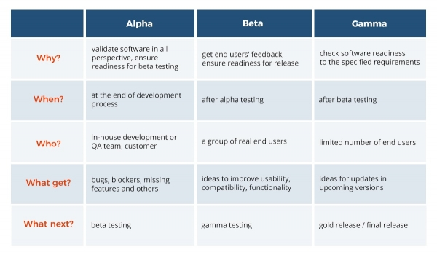

Slide 8

END OF LECTURE
Any Questions !!!

